Slide 1
Project BHS
By: Nicole, Fernando, Emily, Adri, Auburn, and Patrik

Slide 2
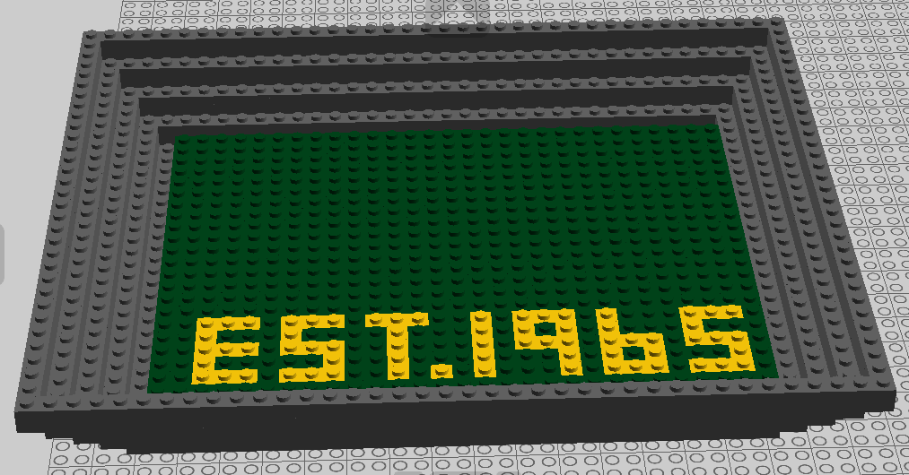
The Pit

Slide 3
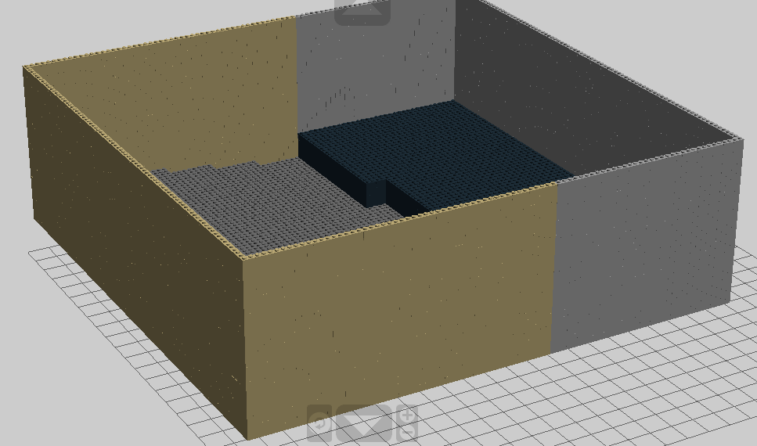
Auditorium

Slide 4
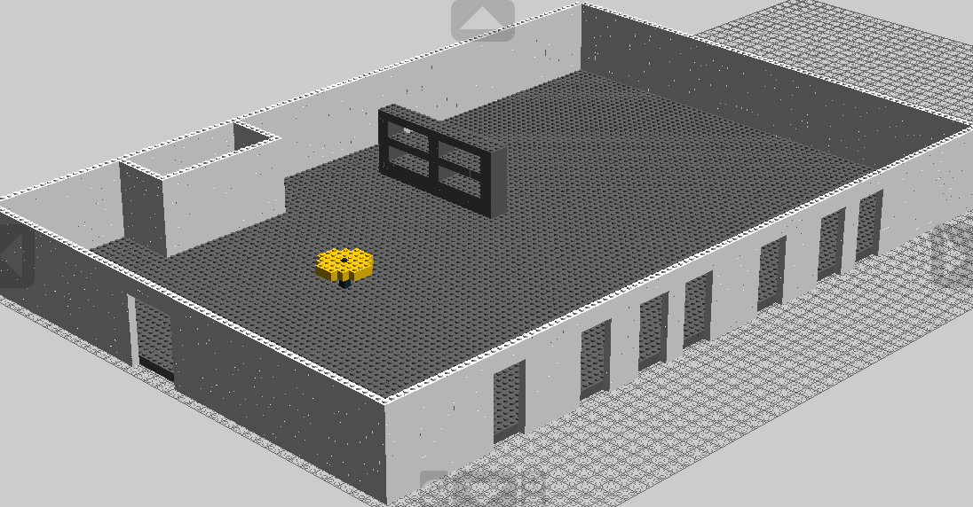
Library

Slide 5
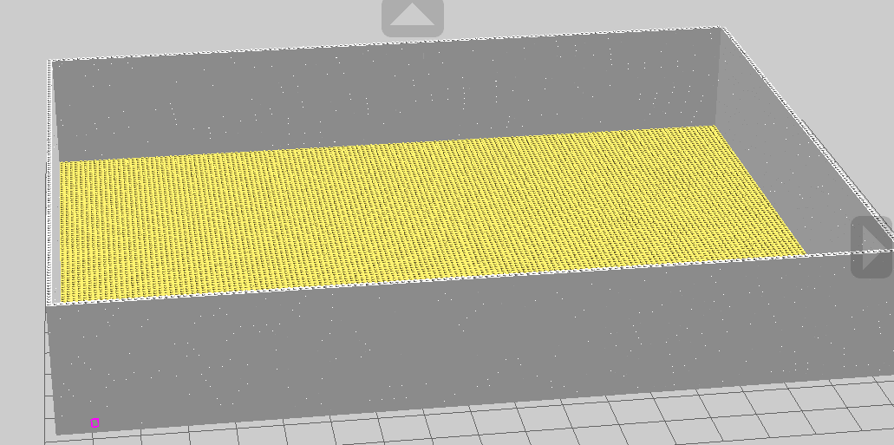
Gym

Slide 6
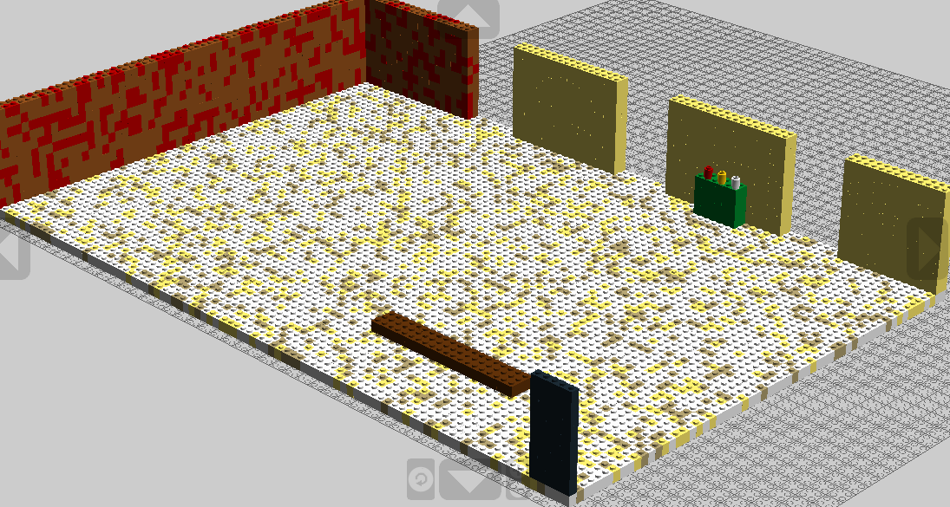
Cafeteria

Slide 7
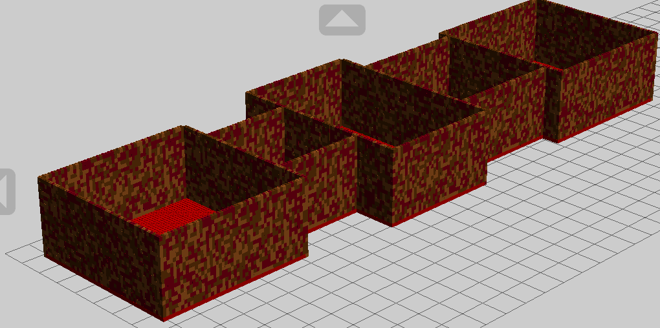
Perimeter

Slide 8
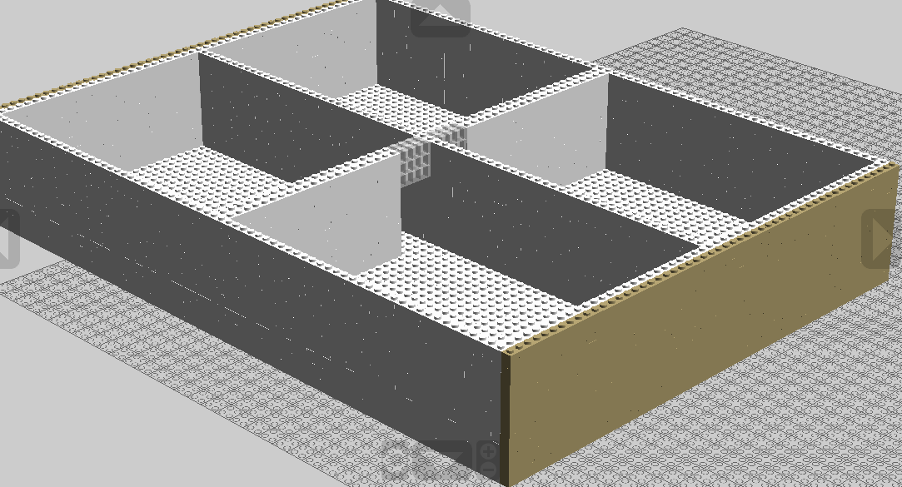
Classrooms

